Slide 1

Normal Distribution
It’s a normal thing!

Slide 2
The Normal Distribution
f(X)
Changing μ shifts the distribution left or right.
Changing σ increases or decreases the spread.
X

Slide 3
The Normal Distribution: as mathematical function (pdf)
This is a bell shaped curve with different centers and spreads depending on μ and σ
Note constants:
π=3.14159
e=2.71828

Slide 4
The Normal PDF
It’s a probability function, so no matter what the values of μ and σ, must integrate to 1!

Slide 5
Normal distribution is defined by its mean and standard dev.
E(X)=μ =
Var(X)=σ² =
Standard Deviation(X)=σ

Slide 6
The beauty of the normal curve:
No matter what μ and σ are, the area between μ-σ and μ+σ is about 68%; the area between μ-2σ and μ+2σ is about 95%; and the area between μ-3σ and μ+3σ is about 99.7%. Almost all values fall within 3 standard deviations.

Slide 7
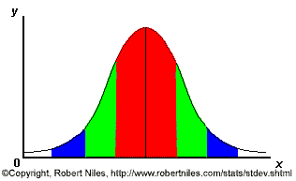
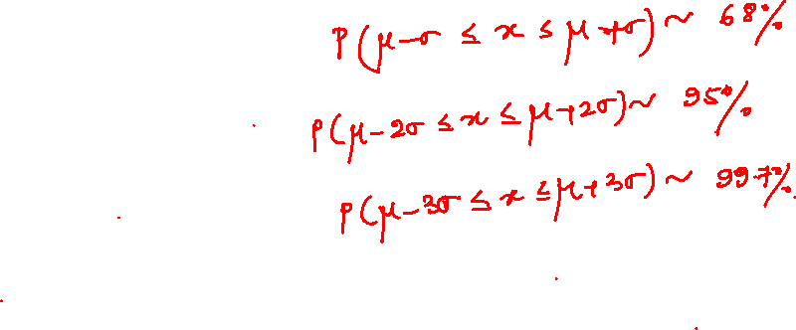
68-95-99.7 Rule
68% of the data
95% of the data
99.7% of the data
Notes:
SAY: within 1 standard deviation either way of the mean
within 2 standard deviations of the mean
within 3 standard deviations either way of the mean
WORKS FOR ALL NORMAL CURVES NO MATTER HOW SKINNY OR FAT

Slide 8
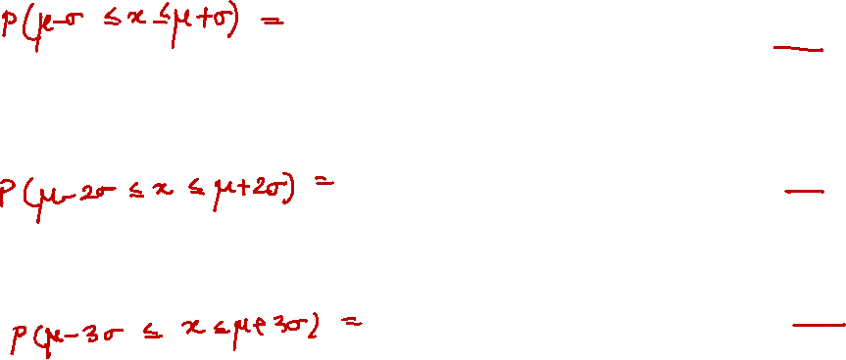
68-95-99.7 Rule in Math terms…

Slide 9
How good is rule for real data?
Check some example data:
The mean of the weight of the women = 127.8
The standard deviation (SD) = 15.5

Slide 10

68% of 120 = .68x120 = ~ 82 runners
In fact, 79 runners fall within 1-SD (15.5 lbs) of the mean.
112.3
127.8
143.3

Slide 11
95% of 120 = .95 x 120 = ~ 114 runners
In fact, 115 runners fall within 2-SD’s of the mean.
96.8
127.8
158.8

Slide 12
99.7% of 120 = .997 x 120 = 119.6 runners
In fact, all 120 runners fall within 3-SD’s of the mean.
81.3
127.8
174.3

Slide 13
Example
Suppose SAT scores roughly follows a normal distribution in the U.S. population of college-bound students (with range restricted to 200-800), and the average math SAT is 500 with a standard deviation of 50, then:
68% of students will have scores between 450 and 550
95% will be between 400 and 600
99.7% will be between 350 and 650

Slide 14
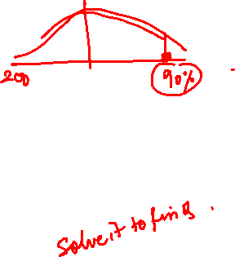
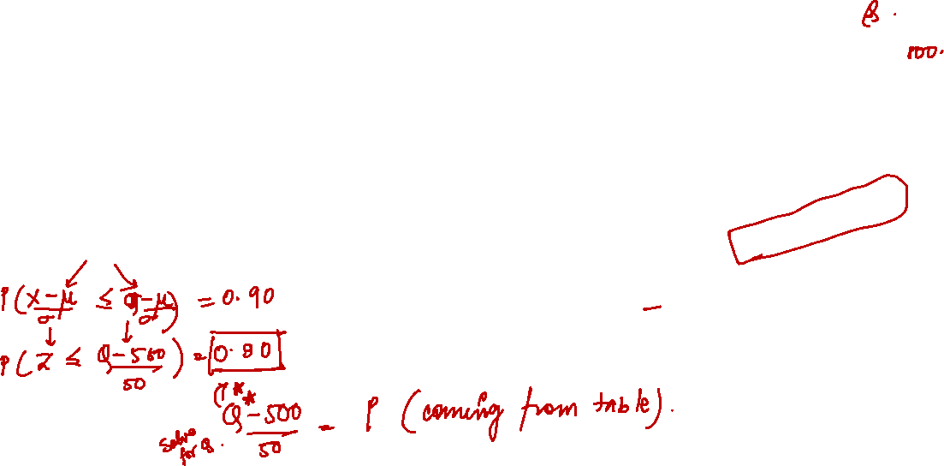
Example
BUT…
What if you wanted to know the math SAT score corresponding to the 90th percentile (=90% of students are lower)?
P(X≤Q) = .90 →
Solve for Q….Like Seriously??

Slide 15

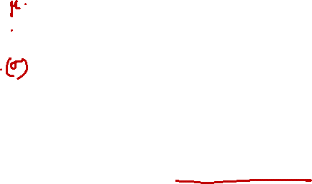
The Standard Normal (Z):
The formula for the standardized normal probability density function is

Slide 16
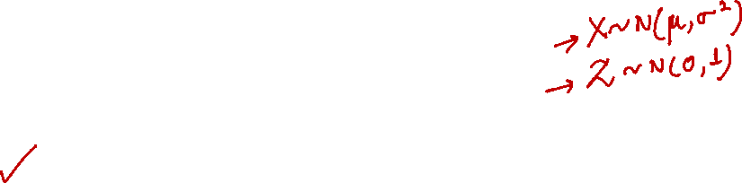
The Standard Normal Distribution (Z)
All normal distributions can be converted into the standard normal curve by subtracting the mean and dividing by the standard deviation:
Somebody calculated all the integrals for the standard normal and put them in a table! So we never have to integrate!
Even better, computers now do all the integration.

Slide 17
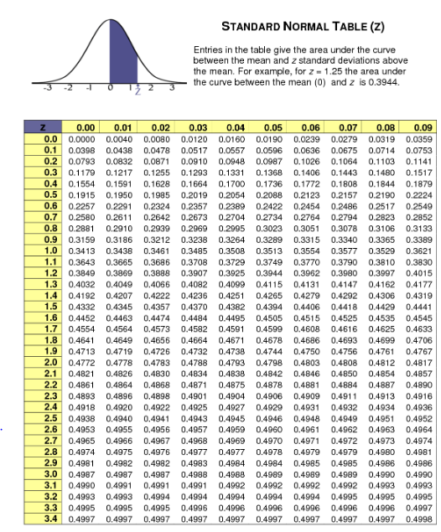
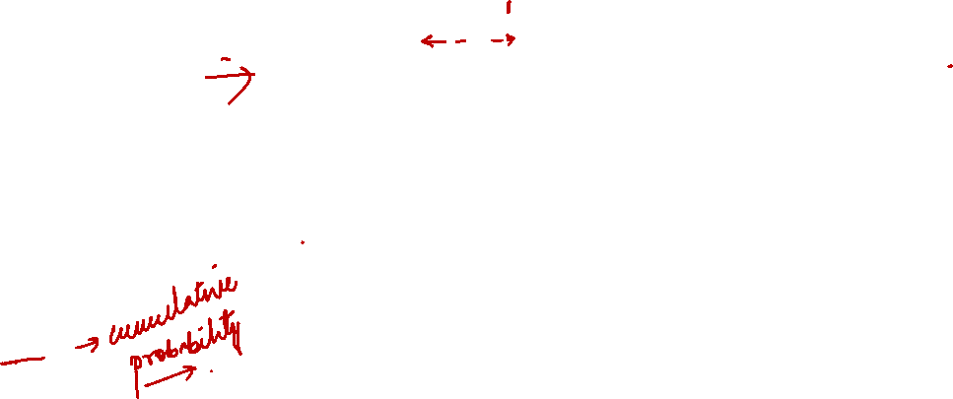
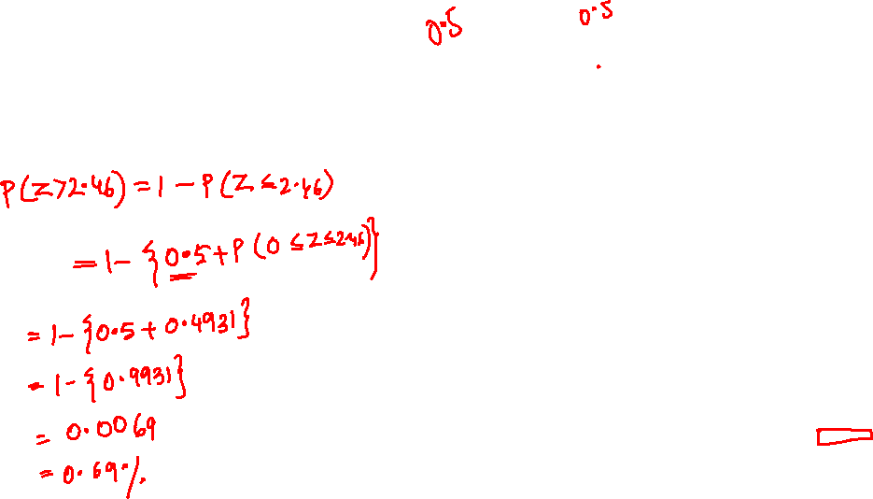
Z Table

Slide 18
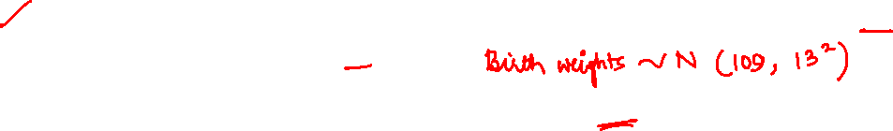
Practice problem
If birth weights in a population are normally distributed with a mean of 109 oz and a standard deviation of 13 oz,
What is the chance of obtaining a birth weight of 141 oz or heavier when sampling birth records at random?
What is the chance of obtaining a birth weight of 120 or lighter?

Slide 19
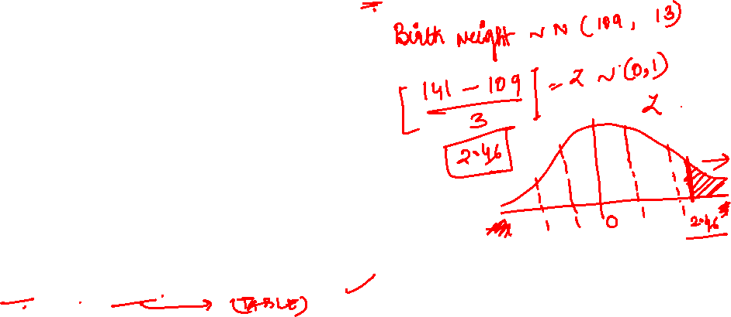
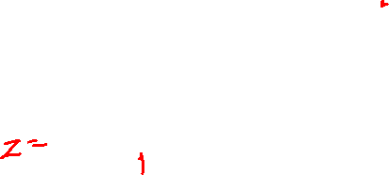
Answer
What is the chance of obtaining a birth weight of 141 oz or heavier when sampling birth records at random?
From the chart → Z of .46 corresponds to a right tail (greater than) area of: P(Z≥2.46) = 1-(.9931)= .0069 or .69 %

Slide 20
Answer
b. What is the chance of obtaining a birth weight of 120 or lighter?
From the chart or SAS → Z of .85 corresponds to a left tail area of:
P(Z≤.85) = .8023= 80.23%

Slide 21
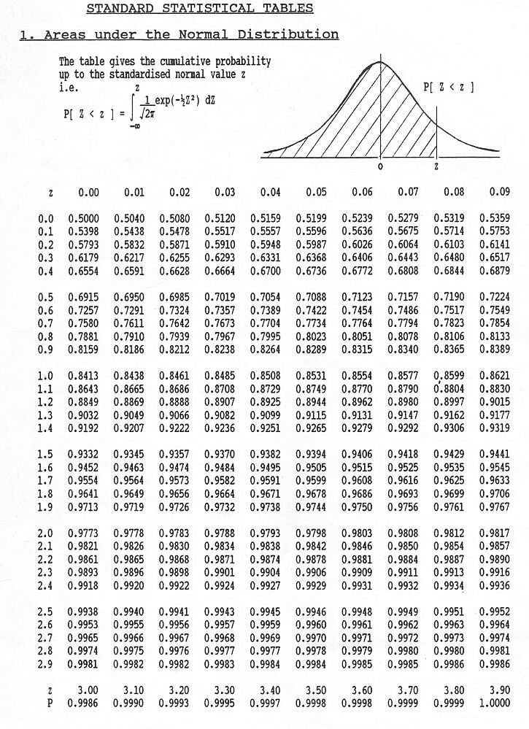
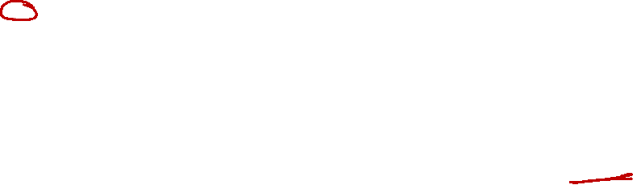
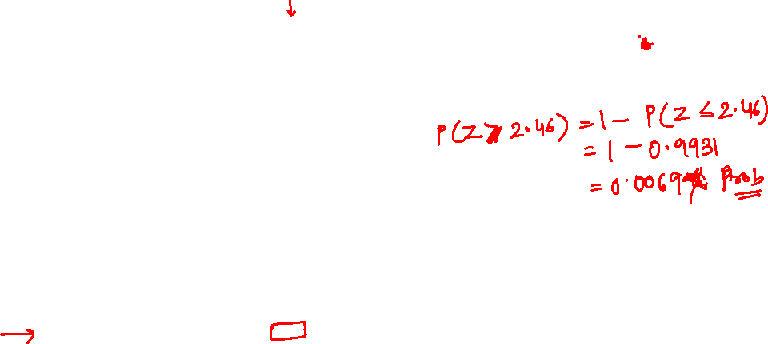

Looking up probabilities in the standard normal table
What is the area to the left of Z=1.51 in a standard normal curve?
Area is 93.45%
Z=1.51
Z=1.51

